Slide 1
Elimination Reactions

Slide 2
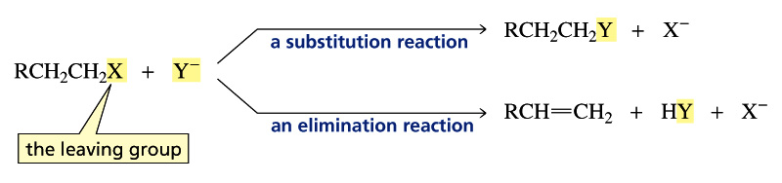
Alkyl Halides: Reactions
Carbon bonded to X is electron-poor (electrophilic)
Will react with nucleophiles
Nucleophiles are also bases! So, there are two competing reactions:
Substitution
Nucleophile substitutes for X (the leaving group)
Elimination
Nucleophile/base removes H, eliminates HX to yield an alkene

Slide 3
Learning Goals
Mechanisms of substitution
Mechanisms of elimination
Substitution vs. Elimination

Slide 4
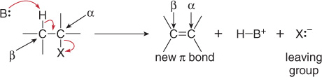
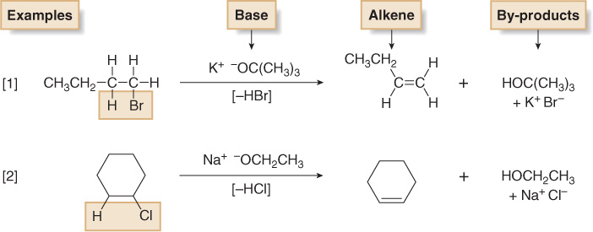
Elimination Reaction

Slide 5
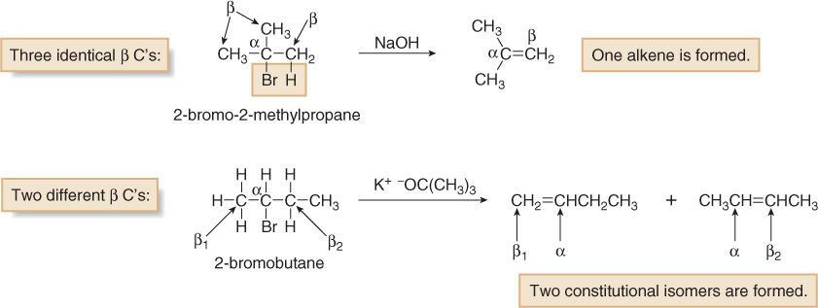
What if Multiple β-Hydrogens Exist?
Same starting material can produce different products

Slide 6
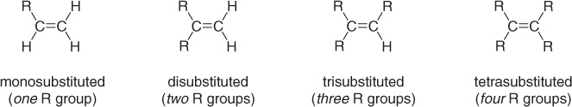
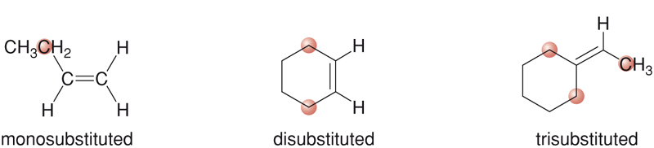
Classification of Alkenes
Alkenes are classified by the number of carbon atoms bonded to the carbons of the double bond.

Slide 7
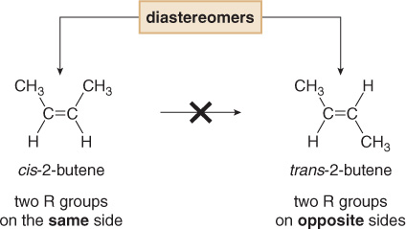
Alkene Stereoisomers
Because there is no free-rotation across pi-bonds, two stereoisomers of 2-butene are possible.
cis-2-Butene and trans-2-butene are diastereomers, because they are stereoisomers that are not mirror images of each other.

Slide 8
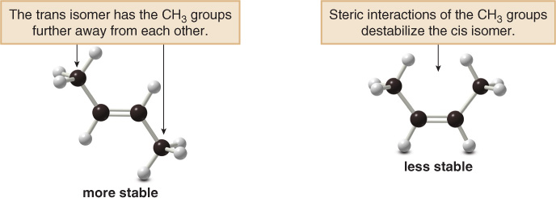
Alkene Stability
Trans alkenes are more stable than cis alkenes because the groups bonded to the double bond carbons are further apart, reducing steric interactions.

Slide 9
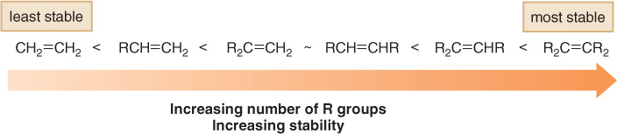
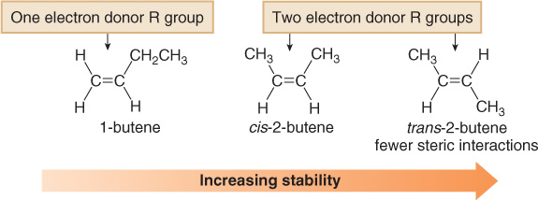
Alkene Stability

Slide 10
Elimination Mechanisms
There are two mechanisms of elimination—E2 and E1, just as there are two mechanisms of substitution, S_{N}2 and S_{N}1.
E2 mechanism—bimolecular elimination
E1 mechanism—unimolecular elimination
The E2 and E1 mechanisms differ in the timing of bond cleavage and bond formation, (similar to the S_{N}2 and S_{N}1 mechanisms).
E2 and S_{N}2 reactions have some features in common, and so do E1 and S_{N}1 reactions.

Slide 11
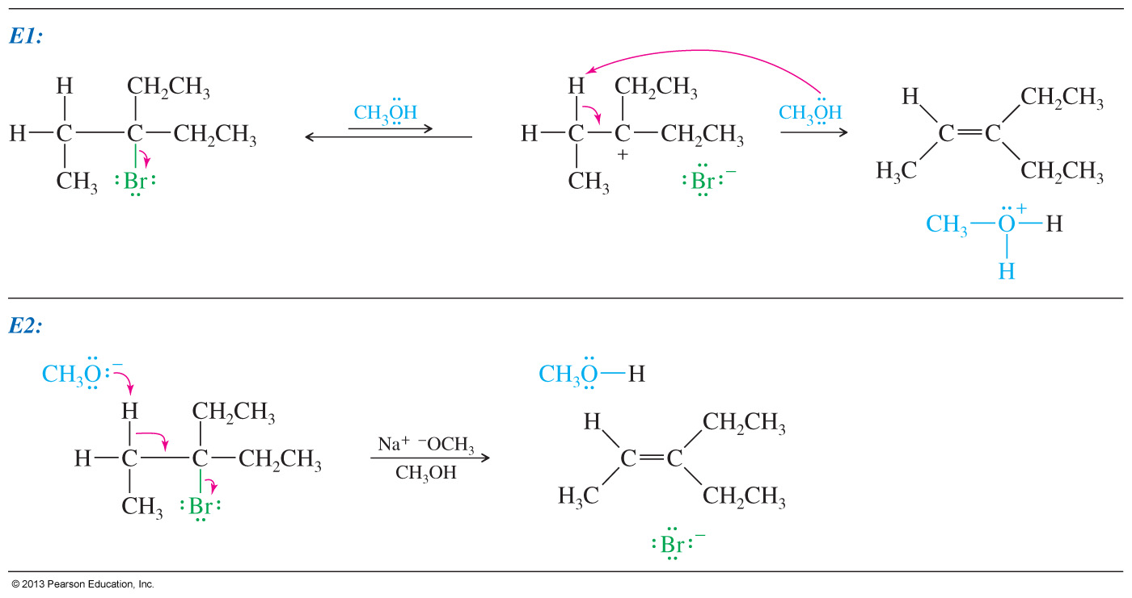
E1 and E2 Mechanisms

Slide 12
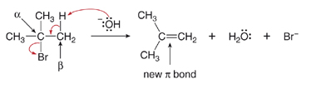
E2 Mechanism
E2 is the most common and it follows second-order kinetics with both the alkyl halide and the base in the rate equation
It exhibits second-order kinetics, and both the alkyl halide and the base appear in the rate equation, i.e.,
rate = k[(CH₃)₃CBr][¯OH]
The reaction is concerted—all bonds are broken and formed in a single step.

Slide 13
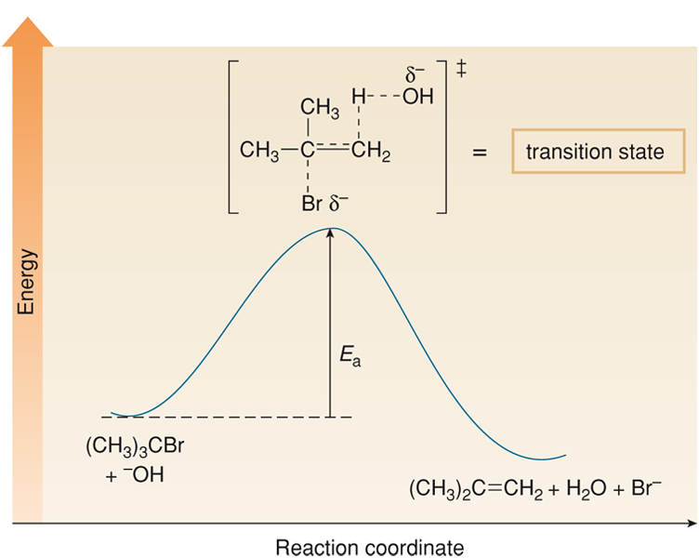
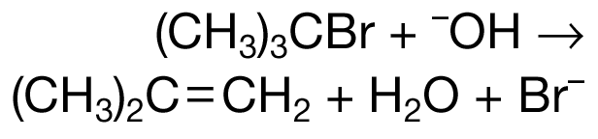
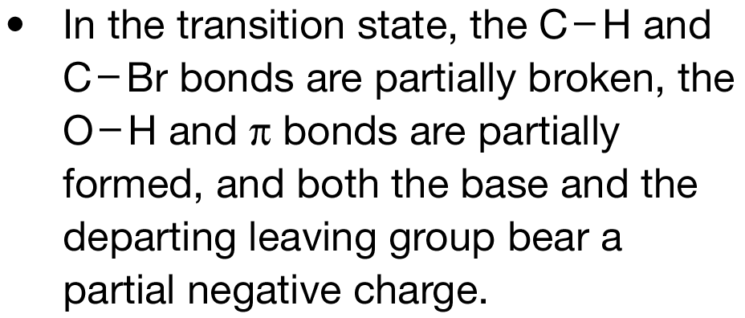
E2 Reaction: Energy Profile Diagram

Slide 14
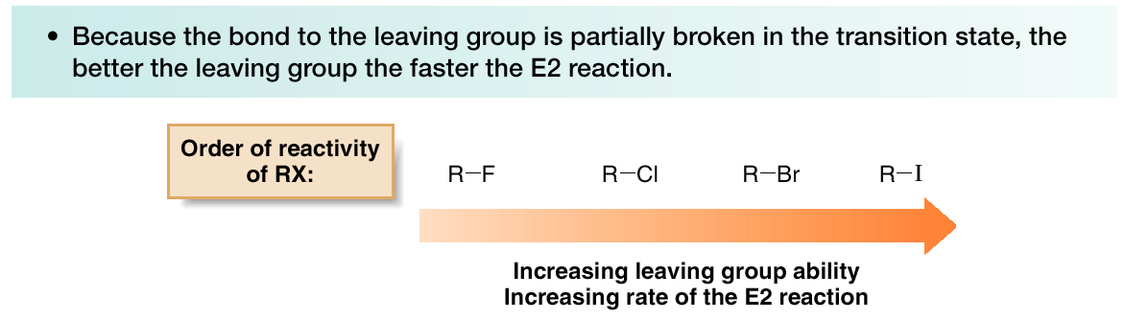
E2 Reaction: Effect of Leaving Group and Solvent
There are similarities between the E2 and S_{N}2 reactions
Polar aprotic solvents are good for E2 reactions

Slide 15
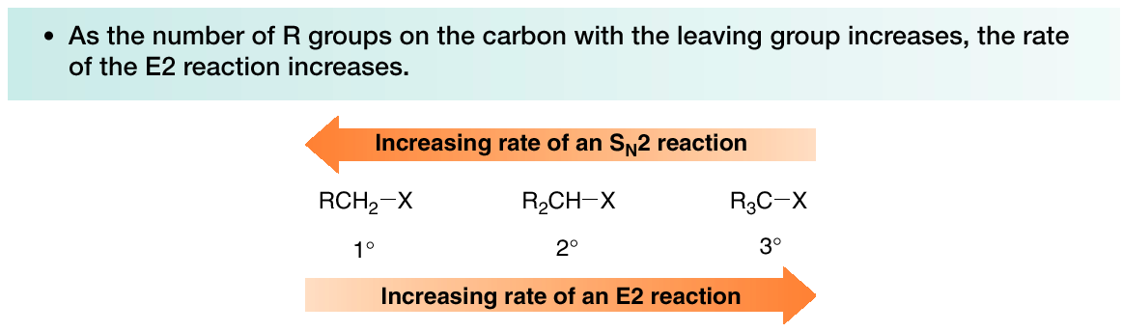
E2 Reaction: Effect of Alkyl Halide Structure
The S_{N}2 and E2 mechanisms differ in how the R group affects
the reaction rate.

Slide 16
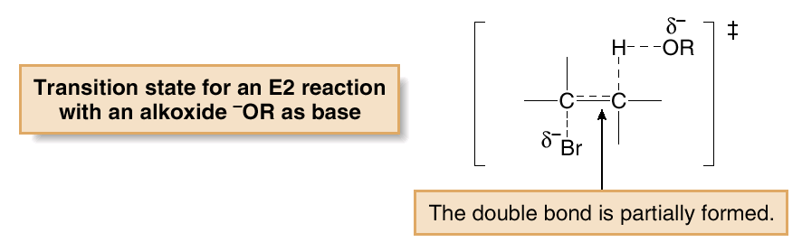
E2 Reaction: Effect of Alkyl Halide Structure
The increase in E2 reaction rate with increasing alkyl substitution can be rationalized in terms of transition state stability.
In the transition state, the double bond is partially formed. Thus, increasing the stability of the double bond with alkyl substituents stabilizes the transition state (i.e., lowers E_{a}, which increases the rate of the reaction.

Slide 17
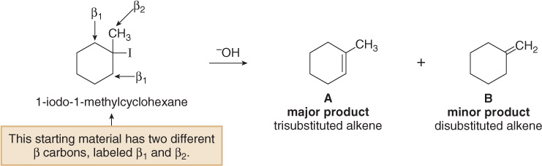
E2 Reaction: The Zaitsev (Saytzeff) Rule
When alkyl halides have two or more different β carbons, more than one alkene product is formed.
When this happens, one of the products usually predominates.
The major product is the more stable product—the one with the more substituted double bond.
This phenomenon is called the Zaitsev rule.
Notes:
File Name: AACXSGA0

Slide 18
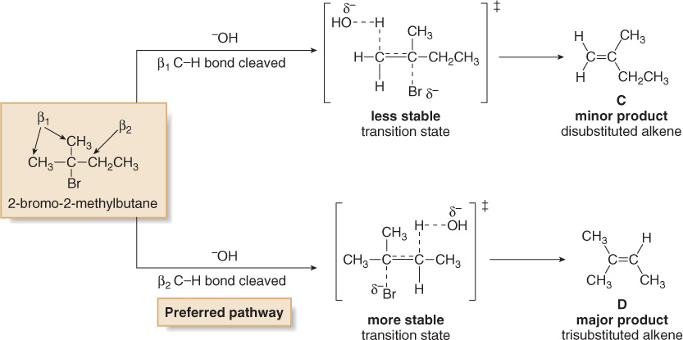
E2 Reaction: The Zaitsev (Saytzeff) Rule
The Zaitsev rule: the major product in β elimination has the more substituted double bond.
A reaction is regioselective when it yields predominantly or exclusively one constitutional isomer when more than one is possible. Thus, the E2 reaction is regioselective.

Slide 19
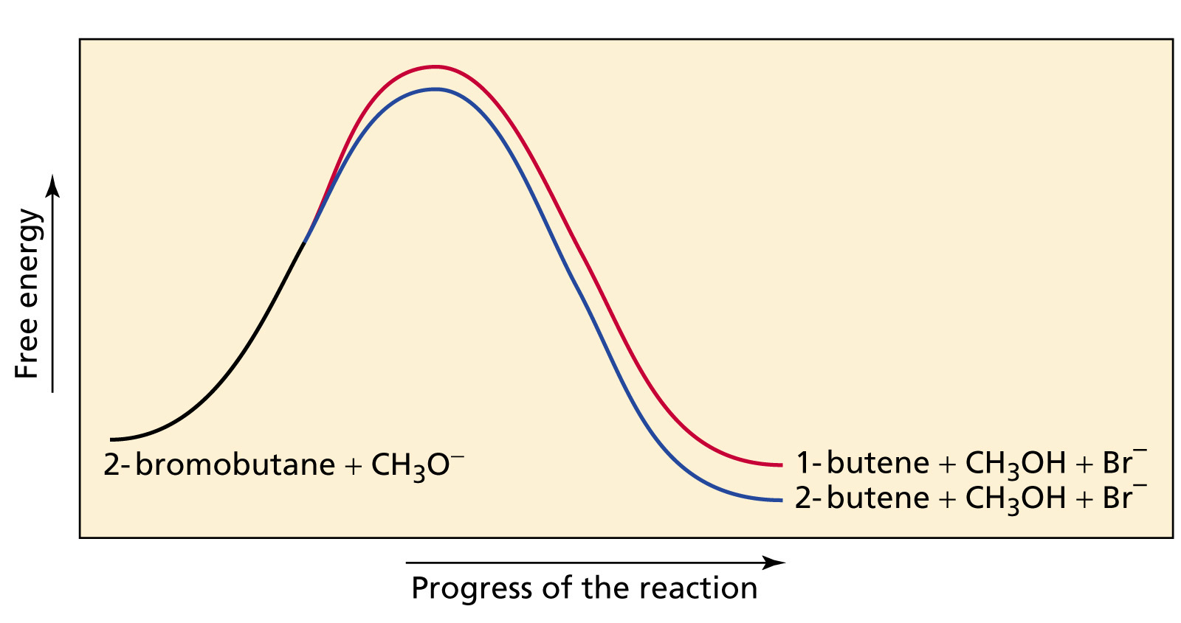
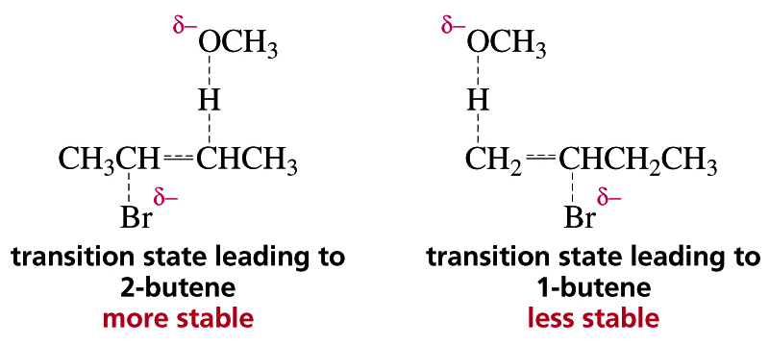
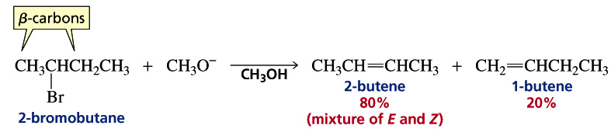
E2 Reaction: Regioselectivity

Slide 20
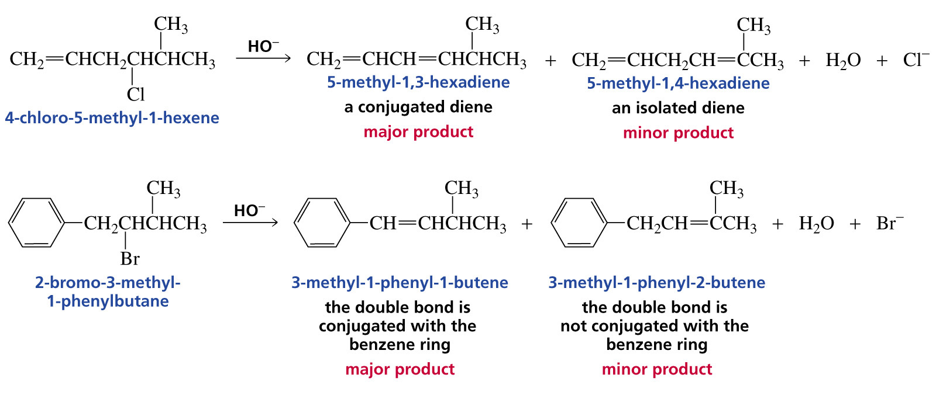
E2 Reaction: Exceptions to the Zaitsev (Saytzeff) Rule
Conjugated alkene products are preferred over the more substituted
alkene product

Slide 21
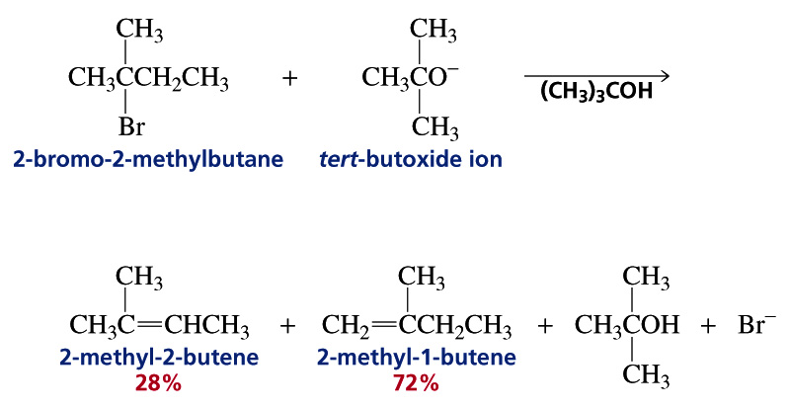
E2 Reaction: Exceptions to the Zaitsev (Saytzeff) Rule
Bulky bases work against the Zaitsev rule.
Remember that comparing product stability means that
thermodynamics is being considered
Using a bulky base impacts the kinetics (activation energy) because of the greater steric hindrance in approaching the alkyl halide

Slide 22
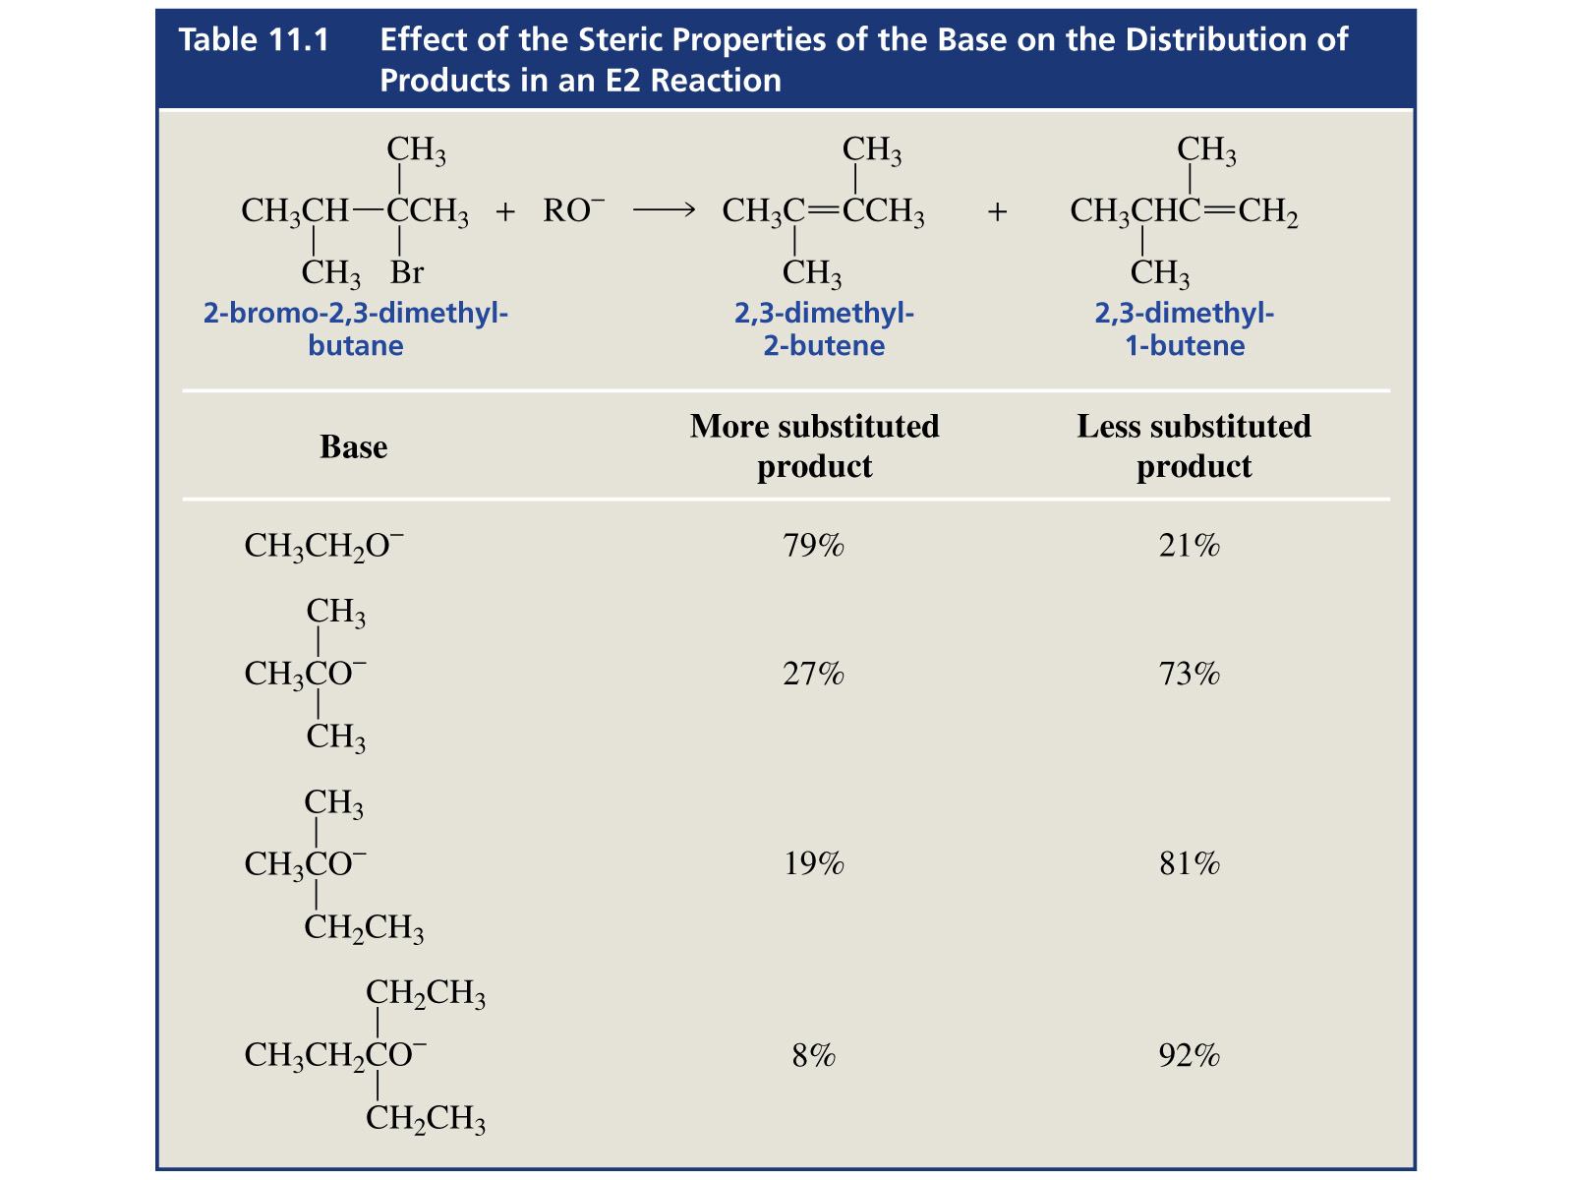
E2 Reaction: Exceptions to the Zaitsev (Saytzeff) Rule

Slide 23
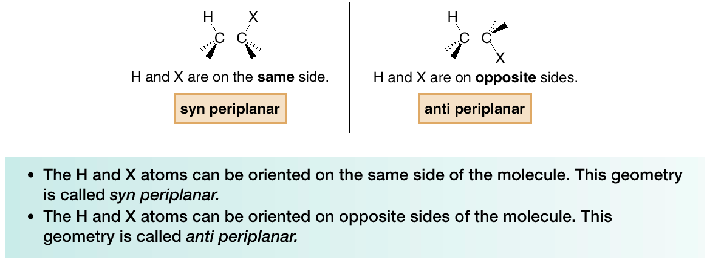
E2 Reaction: Stereochemistry
The transition state of an E2 reaction consists of four atoms from an alkyl halide—one hydrogen atom, two carbon atoms, and the leaving group (X)—all aligned in a plane. There are two ways for the C—H and C—X bonds to be coplanar.
E2 elimination occurs in the anti periplanar geometry. This arrangement allows the molecule to react in the lower energy staggered conformation, and allows the incoming base and leaving group to be further away from each other.

Slide 24
E2 Reaction: Stereochemistry
The halide and the proton to be abstracted must be anti-coplanar (θ = 180º) to each other for the elimination to occur.
The orbitals of the hydrogen atom and the halide must be aligned so they can begin to form a pi bond in the transition state.
The anti-coplanar arrangement minimizes any steric hindrance between the base and the leaving group.

Slide 25
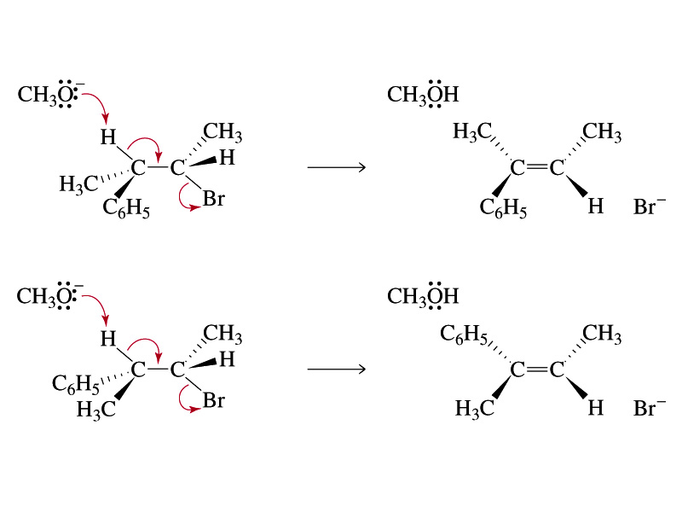
E2 Reaction: Configuration of Precursor
Impacts Outcome

Slide 26
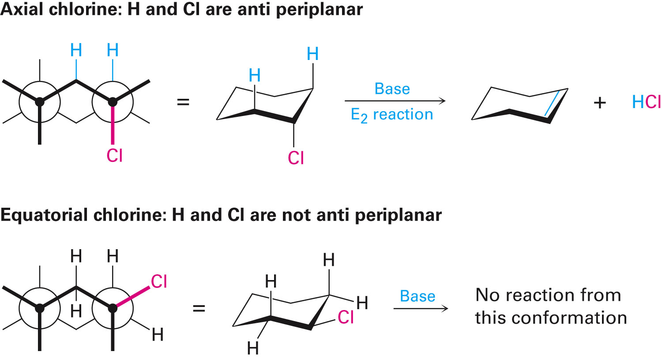
E2 Reaction: Cyclic Compounds
Abstracted proton and leaving group should align trans-diaxial to be anti periplanar in approaching transition state
Equatorial groups are not in proper alignment

Slide 27
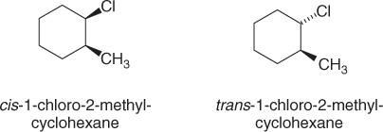
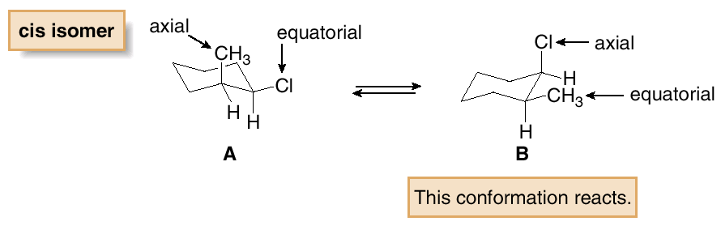
E2 Reaction: Cyclic Compounds
Now consider the E2 dehydrohalogenation of cis- and trans-1-chloro-2-methylcyclohexane.
This cis isomer exists as two conformations, A and B, each of which as one group axial and one group equatorial. E2 reaction must occur from conformation B, which contains an axial Cl atom.

Slide 28
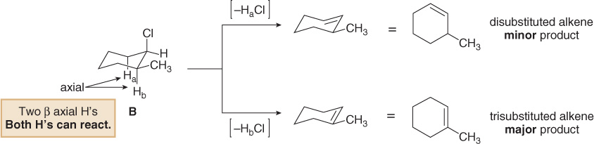
E2 Reaction: Cyclic Compounds
Because conformation B has two different axial β hydrogens, labeled H_{a} and H_{b}, E2 reaction occurs in two different directions to afford two alkenes.
The major product contains the more stable trisubstituted double bond, as predicted by the Zaitsev rule.

Slide 29
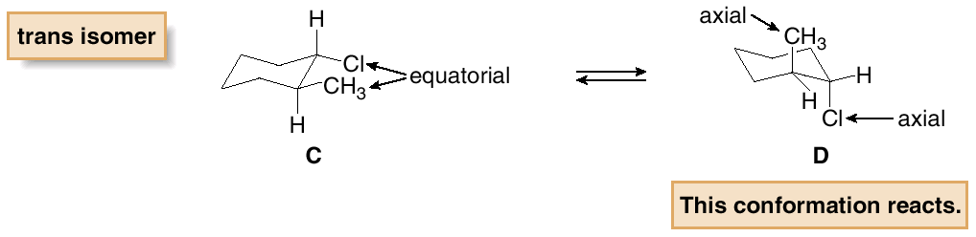
E2 Reaction: Cyclic Compounds
The trans isomer of 1-chloro-2-methylcyclohexane exists as two conformers: C, having two equatorial substituents, and D, having two axial substituents.
E2 reaction must occur from D, since it contains an axial Cl atom.

Slide 30
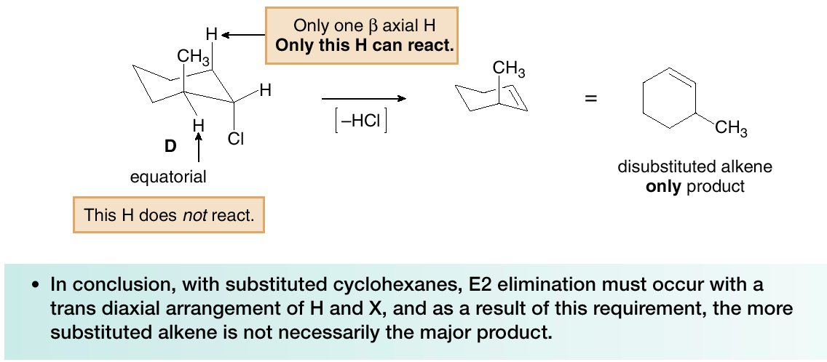
E2 Reaction: Cyclic Compounds
Because conformer D has only one axial β H, the E2 reaction occurs only in one direction to afford a single product. This is not predicted by the Zaitsev rule.

Slide 31
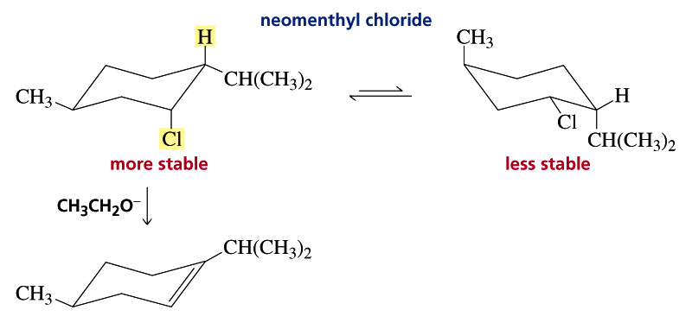
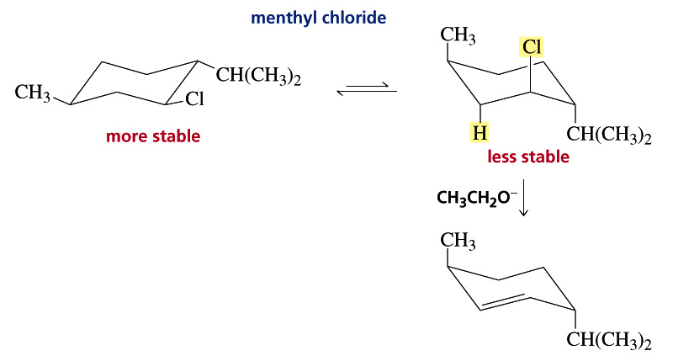
E2 Reaction: Cyclic Compounds
The most substituted alkene is not formed because the eliminating groups must be antiperiplanar

Slide 32
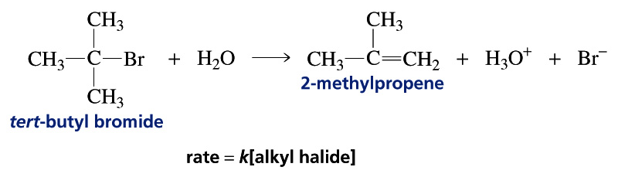
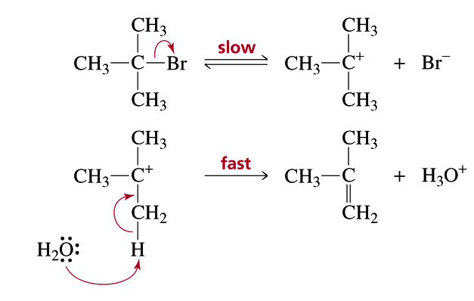
E1 Elimination
E1 eliminations typically occur with weaker bases.
Mechanism:

Slide 33
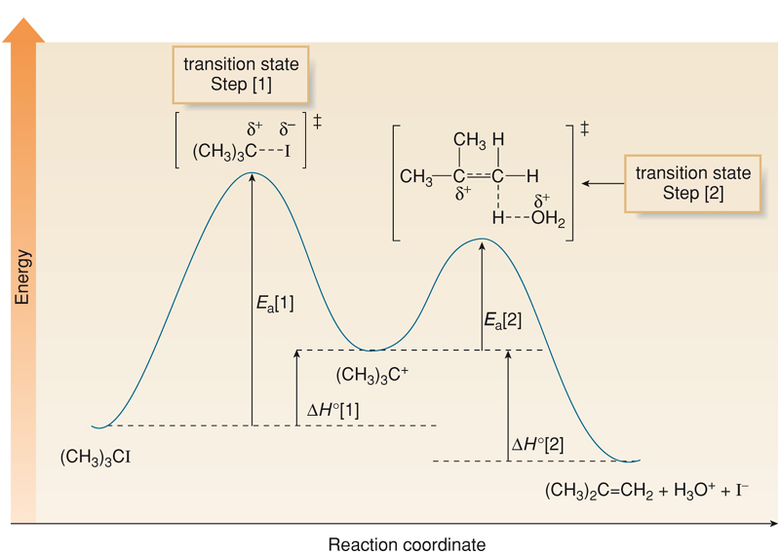
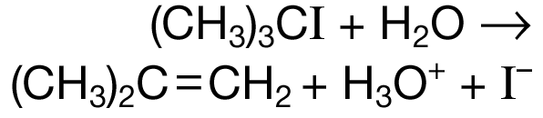
E1 Reaction: Energy Profile Diagram

Slide 34
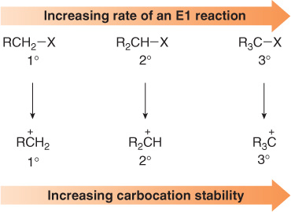
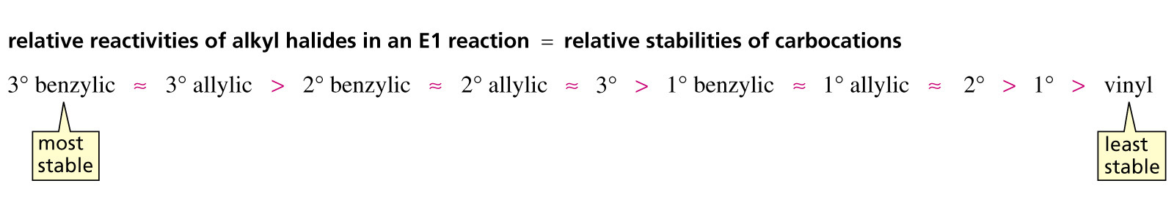
E1 Reaction: Effect of Alkyl Halide Structure
The rate of an E1 reaction increases as the number of R groups on the carbon with the leaving group increases.

Slide 35
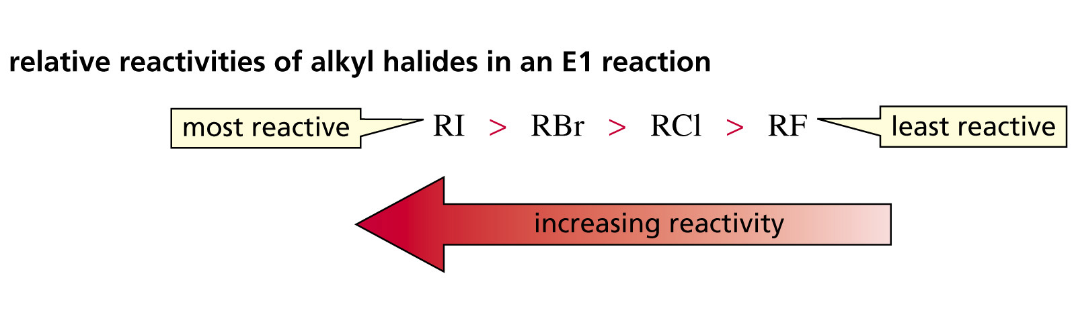
E1 Reaction: Effect of Leaving Group

Slide 36
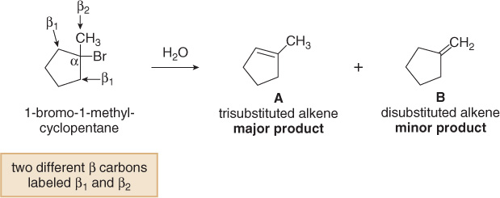
E1 Reaction: Zaitsev Rule Applies

Slide 37
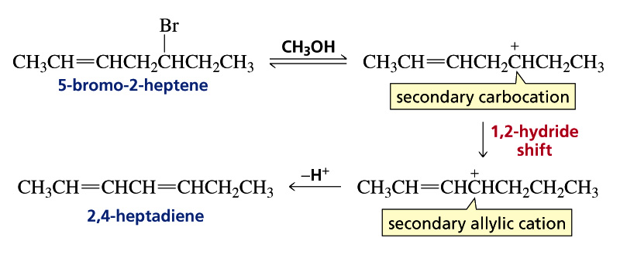
E1 Reaction: Carbocation Rearrangements Occur

Slide 38
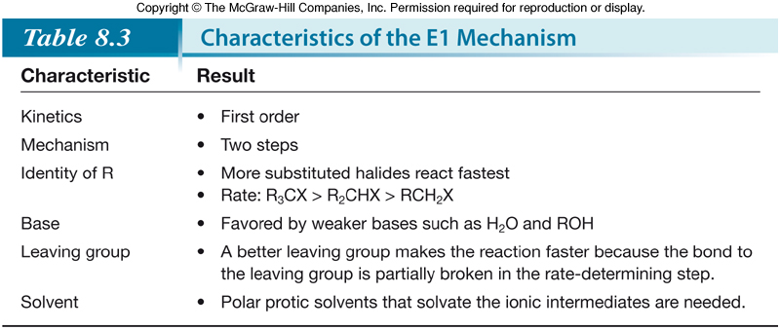
E1 Reaction: Summary

Slide 39
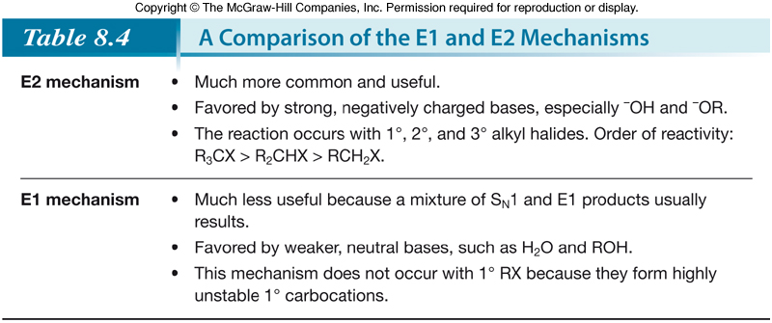
E1 vs E2 Reaction: Summary
The strength of the base is the most important factor in determining the mechanism for elimination. Strong bases favor the E2 mechanism. Weak bases favor the E1 mechanism.

Slide 40
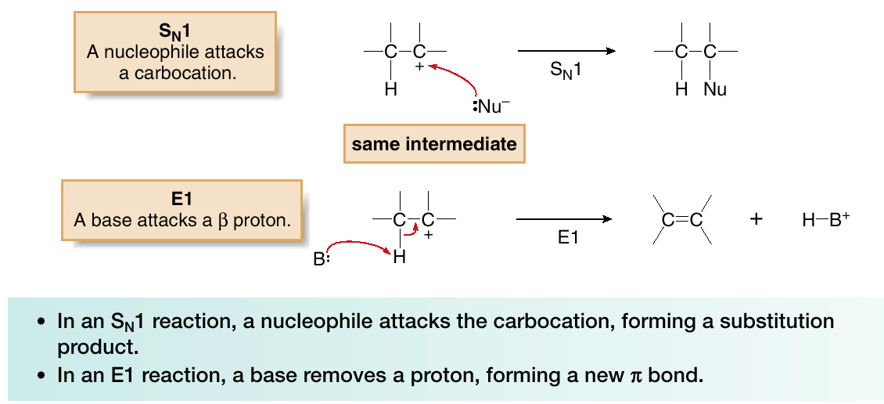
E1 vs S_{N}1 Reaction
S_{N}1 and E1 reactions have exactly the same first step—formation of a carbocation. They differ in what happens to the carbocation.
Because E1 reactions often occur with a competing S_{N}1 reaction, E1 reactions of alkyl halides are much less useful than E2 reactions.

Slide 41
How to Decide Amongst S_{N}1, S_{N}2, E1, E2
3º Alkyl Halides
With strong bases: E2 elimination occurs
With weak nucleophiles or bases: A mixture of products from S_{N}1 and E1 reactions
1º Alkyl Halides
With strong nucleophiles: Substitution occurs by an S_{N}2 mechanism
With strong sterically hindered bases: Elimination occurs by an E2 mechanism
2º Alkyl Halides
With strong bases and nucleophiles: A mixture of SN2 and E2 reaction products are formed
With strong sterically hindered bases: Elimination occurs by an E2 mechanism
With weak nucleophiles or bases: A mixture of SN1 and E1 products results

Slide 42
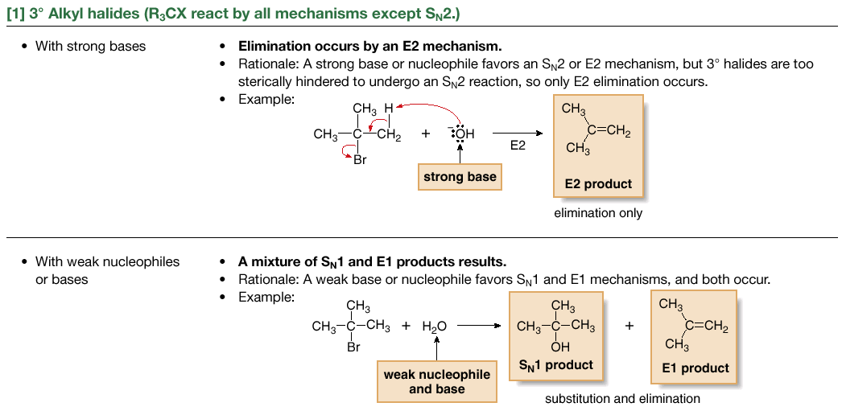
How to Decide Amongst S_{N}1, S_{N}2, E1, E2

Slide 43
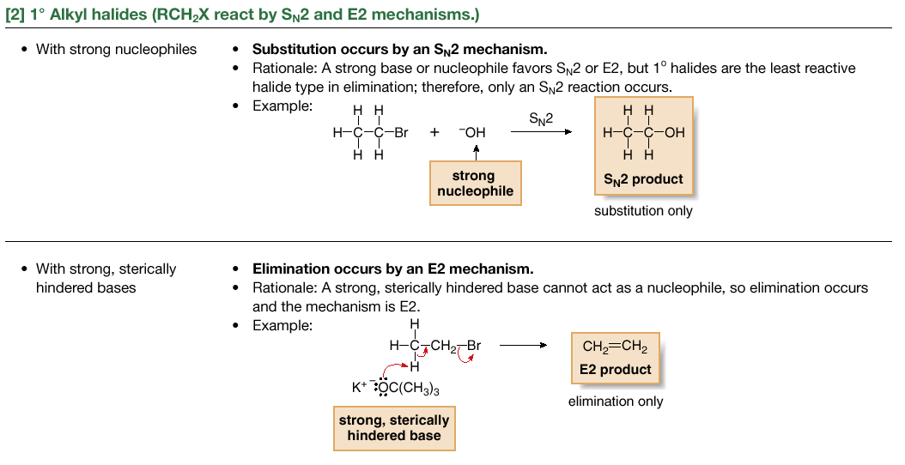
How to Decide Amongst S_{N}1, S_{N}2, E1, E2

Slide 44

How to Decide Amongst S_{N}1, S_{N}2, E1, E2

